Slide 1

NYC Taxi EDA
Rajdeep Biswas
Bellevue University
DSC – 530 Exploratory Data Analytics
August 7th , 2020

Slide 2
Dataset
For this EDA 3 datasets were used from Azure Open Datasets which are hosted in the Azure Blob storage which provides a scalable, cost-efficient object storage in the cloud.
NYC Taxi & Limousine Commission - yellow taxi trip records. This dataset is stored in Parquet format. There are about 1.5B rows (50GB) in total as of 2018.This dataset contains historical records accumulated from 2009 to 2018. View data example here
Blob location* : https://azureopendatastorage.blob.core.windows.net/nyctlc/yellow/puYear=*/puMonth=*/*.parquet
Worldwide public holiday data sourced from PyPI holidays package and Wikipedia, covering 38 countries or regions from 1970 to 2099. This dataset is stored in Parquet format. It is a snapshot with holiday information from 1970-01-01 to 2099-01-01. The data size is about 500KB. View data example here
Blob location*: https://azureopendatastorage.blob.core.windows.net/holidaydatacontainer/Processed/*.parquet
Worldwide hourly weather history data (example: temperature, precipitation, wind) sourced from the National Oceanic and Atmospheric Administration (NOAA).This dataset is stored in Parquet format. It is updated daily and contains about 400M rows (20GB) in total as of 2019.This dataset contains historical records accumulated from 2008 to the present. View data example here
Blob location*: https://azureopendatastorage.blob.core.windows.net/isdweatherdatacontainer/ISDWeather/year=*/month=*/*.parquet
*Note: the blob location is not accessible from browser.
Ref: https://azure.microsoft.com/en-us/services/open-datasets/
https://azure.microsoft.com/en-us/services/storage/blobs/

Slide 3
NYC Taxi & Limousine Commission - yellow taxi trip records
Name | Data type | Unique | Values (sample) | Description
doLocationId | string | 265 | 161 236 | TLC Taxi Zone in which the taximeter was disengaged.
endLat | double | 961,994 | 41.366138 40.75
endLon | double | 1,144,935 | -73.137393 -73.9824
extra | double | 877 | 0.5 1.0 | Miscellaneous extras and surcharges. Currently, this only includes the $0.50 and $1 rush hour and overnight charges.
fareAmount | double | 18,935 | 6.5 4.5 | The time-and-distance fare calculated by the meter.
improvementSurcharge | string | 60 | 0.3 0 | $0.30 improvement surcharge assessed trips at the flag drop. The improvement surcharge began being levied in 2015.
mtaTax | double | 360 | 0.5 -0.5 | $0.50 MTA tax that is automatically triggered based on the metered rate in use.
passengerCount | int | 64 | 1 2 | The number of passengers in the vehicle. This is a driver-entered value.
paymentType | string | 6,282 | CSH CRD | A numeric code signifying how the passenger paid for the trip. 1= Credit card; 2= Cash; 3= No charge; 4= Dispute; 5= Unknown; 6= Voided trip.

Slide 4
NYC Taxi & Limousine Commission - yellow taxi trip records contd..
Name | Data type | Unique | Values (sample) | Description
puMonth | int | 12 | 3 5
puYear | int | 29 | 2012 2011
rateCodeId | int | 56 | 1 2 | The final rate code in effect at the end of the trip. 1= Standard rate; 2= JFK; 3= Newark; 4= Nassau or Westchester; 5= Negotiated fare; 6= Group ride.
startLat | double | 833,016 | 41.366138 40.7741
startLon | double | 957,428 | -73.137393 -73.9824
storeAndFwdFlag | string | 8 | N 0 | This flag indicates whether the trip record was held in vehicle memory before sending to the vendor, aka “store and forward,” because the vehicle did not have a connection to the server. Y= store and forward trip; N= not a store and forward trip.

Slide 5
NYC Taxi & Limousine Commission - yellow taxi trip records contd..
Name | Data type | Unique | Values (sample) | Description
tipAmount | double | 12,121 | 1.0 2.0 | This field is automatically populated for credit card tips. Cash tips are not included.
tollsAmount | double | 6,634 | 5.33 4.8 | Total amount of all tolls paid in trip.
totalAmount | double | 39,707 | 7.0 7.8 | The total amount charged to passengers. Does not include cash tips.
tpepDropoffDateTime | timestamp | 290,185,010 | 2010-11-07 01:36:00 2011-11-06 01:27:00 | The date and time when the meter was disengaged.
tpepPickupDateTime | timestamp | 289,948,585 | 2009-11-01 01:08:00 2013-11-03 01:33:00 | The date and time when the meter was engaged.
tripDistance | double | 14,003 | 1.0 0.9 | The elapsed trip distance in miles reported by the taximeter.
vendorID | string | 7 | VTS CMT | A code indicating the TPEP provider that provided the record. 1= Creative Mobile Technologies, LLC; 2= VeriFone Inc.
puLocationId | string | 266 | 237 161 | TLC Taxi Zone in which the taximeter was engaged.

Slide 6
Worldwide public holiday data covering 38 countries or regions from 1970 to 2099
Name | Data type | Unique | Values (sample) | Description
countryOrRegion | string | 38 | Sweden Norway | Country or region full name.
countryRegionCode | string | 35 | SE NO | Country or region code following the format here.
date | timestamp | 20,665 | 2025-01-01 00:00:00 2093-12-25 00:00:00 | Date of the holiday.
holidayName | string | 483 | Søndag Söndag | Full name of the holiday.
isPaidTimeOff | boolean | 3 | True | Indicate whether most people have paid time off on this date (only available for US, GB and India now). If it is NULL, it means unknown.
normalizeHolidayName | string | 438 | Søndag Söndag | Normalized name of the holiday.

Slide 7
Worldwide hourly weather history data accumulated from 2008 to the present
Name | Data type | Unique | Values (sample) | Description
cloudCoverage | string | 8 | CLR OVC | The fraction of the sky covered by all the visible clouds.
countryOrRegion | string | 245 | US CA | Country or region code.
datetime | timestamp | 6,612,542 | 2018-03-21 12:00:00 2019-11-01 12:00:00 | The UTC datetime of a GEOPHYSICAL-POINT-OBSERVATION.
day | int | 31 | 1 5 | The day of the column datetime.
elevation | double | 2,364 | 5.0 3.0 | The elevation of a GEOPHYSICAL-POINT-OBSERVATION relative to Mean Sea Level (MSL).
latitude | double | 34,700 | 38.544 31.78 | The latitude coordinate of a GEOPHYSICAL-POINT-OBSERVATION where southern hemisphere is negative.
longitude | double | 58,005 | -86.0 -96.622 | The longitude coordinate of a GEOPHYSICAL-POINT-OBSERVATION where values west from 000000 to 179999 are signed negative.
month | int | 12 | 1 3 | The month of the column datetime.
p_k | string | 17,292 | 999999-23904 999999-03063 | usaf-wban

Slide 8
Worldwide hourly weather history data contd..
Name | Data type | Unique | Values (sample) | Description
pastWeatherIndicator | int | 11 | 2 6 | Retrieve past weather indicator, which shows weather in the past hour
precipDepth | double | 5,628 | 9999.0 3.0 | The depth of LIQUID-PRECIPITATION that is measured at the time of an observation. Units: millimeters. MIN: 0000; MAX: 9998; 9999 = Missing; SCALING FACTOR: 10.
precipTime | double | 44 | 1.0 24.0 | The quantity of time over which the LIQUID-PRECIPITATION was measured. Units: Hours. MIN: 00; MAX: 98; 99 = Missing.
presentWeatherIndicator | int | 101 | 10 5 | Retrieve present weather indicator, which shows weather in the present hour
seaLvlPressure | double | 2,214 | 1015.0 1014.2 | The air pressure relative to Mean Sea Level (MSL). MIN: 08600 MAX: 10900 UNITS: Hectopascals
snowDepth | double | 652 | 1.0 3.0 | The depth of snow and ice on the ground. MIN: 0000 MAX: 1200 UNITS: centimeters
stationName | string | 16,567 | BATESVILLE 8 WNW LA JUNTA 17 WSW | Name of the weather station.
temperature | double | 1,466 | 15.0 13.0 | The temperature of the air. MIN: -0932 MAX: +0618 UNITS: Degrees Celsius

Slide 9
Worldwide hourly weather history data contd..
Name | Data type | Unique | Values (sample) | Description
usaf | string | 16,612 | 999999 062350 | AIR FORCE CATALOG station number.
version | double | 1 | 1.0
wban | string | 2,552 | 99999 23904 | NCDC WBAN number.
windAngle | int | 362 | 180 270 | The angle, measured in a clockwise direction, between true north and the direction from which the wind is blowing. MIN: 001 MAX: 360 UNITS: Angular Degrees
windSpeed | double | 617 | 2.1 1.5 | The rate of horizontal travel of air past a fixed point. MIN: 0000 MAX: 0900 UNITS: meters per second
year | int | 13 | 2019 2018 | The year of the column datetime.
usaf | string | 16,612 | 999999 062350 | AIR FORCE CATALOG station number.
version | double | 1 | 1.0

Slide 10
Goals
1. Exploratory data analytics of the NYC Taxi & Limousine Commission - yellow taxi trip records. Time series, seasonality, and outlier analysis by using the Worldwide public holiday data and Worldwide hourly weather history data.
2. Prediction of whether a taxi trip will result in a tip or not using logistic regression

Slide 11
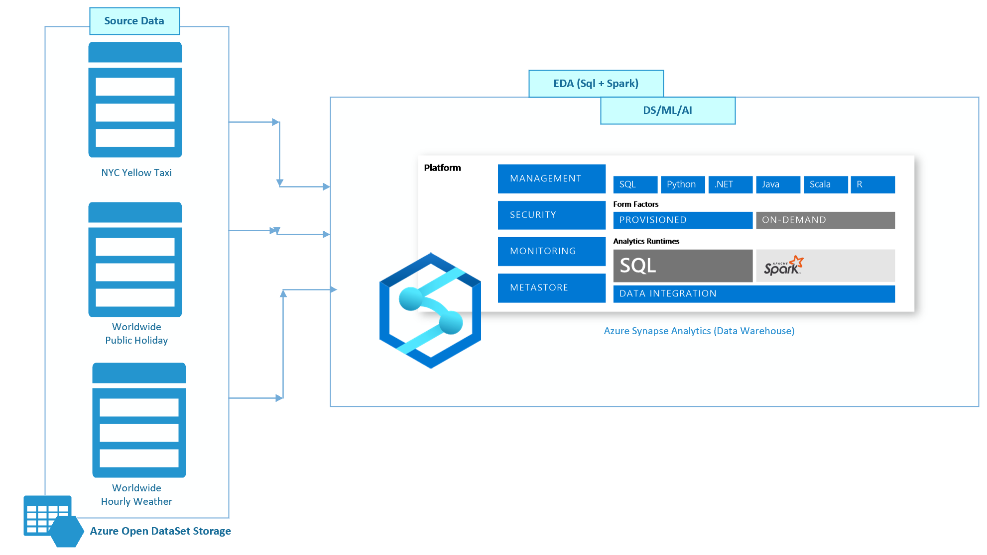
Architecture
Azure Synapse is Azure SQL Data Warehouse evolved—blending big data, data warehousing, and data integration into a single service for end-to-end analytics at cloud scale.

Slide 12
Variables of Interest -> From raw
Name | Data type | Unique | Values (sample) | Description
tpepPickupDateTime | timestamp | 289,948,585 | 2009-11-01 01:08:00 2013-11-03 01:33:00 | The date and time when the meter was engaged.
passengerCount | int | 64 | 1 2 | The number of passengers in the vehicle. This is a driver-entered value.
tripDistance | double | 14,003 | 1.0 0.9 | The elapsed trip distance in miles reported by the taximeter.
fareAmount | double | 18,935 | 6.5 4.5 | The time-and-distance fare calculated by the meter.
paymentType | string | 6,282 | CSH CRD | A numeric code signifying how the passenger paid for the trip. 1= Credit card; 2= Cash; 3= No charge; 4= Dispute; 5= Unknown; 6= Voided trip.
tipAmount | double | 12,121 | 1.0 2.0 | This field is automatically populated for credit card tips. Cash tips are not included.

Slide 13
Variables of Interest -> Recodes
Name | Data type | Unique | Values (sample) | Description
tipped | 2 | 2 | 0 1 | Labeling for binary classification (will there be a tip or not on a given trip) converting the tip amount into a 0 or 1 value.
weekdayVec | vector | 7 | 1 2 | The weekdayString columns need to be converted into integer representations. There are multiple approaches to performing the conversion, however the approach taken in this example is OneHotEncoding, a common approach.
trafficTimeBinsVec | vector | 4 | 1 2 | The trafficTimeBins columns need to be converted into integer representations. There are multiple approaches to performing the conversion, however the approach taken in this example is OneHotEncoding, a common approach. when((taxi_df.pickupHour <= 6) | (taxi_df.pickupHour >= 20),"Night")\ .when((taxi_df.pickupHour >= 7) & (taxi_df.pickupHour <= 10), "AMRush")\ .when((taxi_df.pickupHour >= 11) & (taxi_df.pickupHour <= 15), "Afternoon")\ .when((taxi_df.pickupHour >= 16) & (taxi_df.pickupHour <= 19), "PMRush")\ .otherwise(0).alias('trafficTimeBins')
pickupHour | string | 12 | 01 - 12 | date_format('tpepPickupDateTime', 'hh').alias('pickupHour')

Slide 14
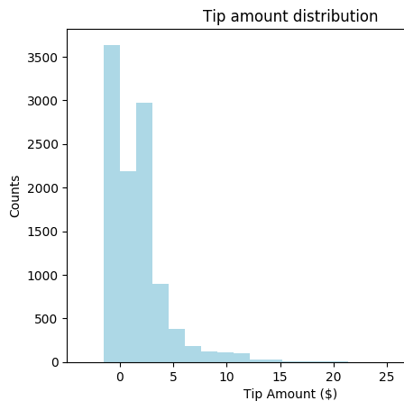
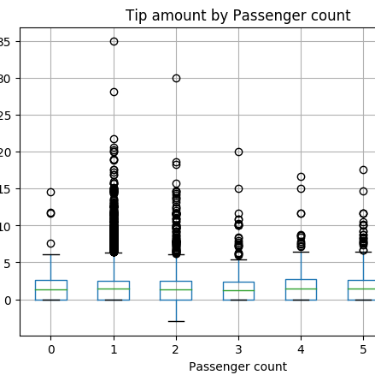
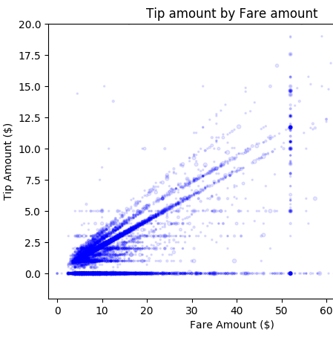
Plots (Histogram, Box and Scatter)
Different visualizations of the data related to tips that lead to conclusions about the state and quality of the data.

Slide 15
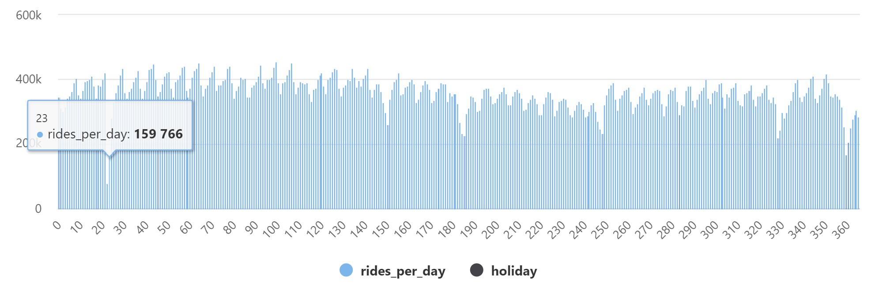
Analysis from Visualization
Let us focus the analysis on a single year, for example, 2016. From the plot chart, we can see that there's a weekly pattern, with Saturdays as the peak day. During summer months, there are fewer taxi rides because of vacations. There are also some significant drops in the number of taxi rides without a clear pattern of when and why they occur. Next, let's see if the drops correlate with public holidays by joining the NYC Taxi rides dataset with the Public Holidays dataset.
From the plot chart, you can see that during public holidays the number of taxi rides is lower. There's still one unexplained large drop on January 23. Let's check the weather in NYC on that day by querying the Weather Data dataset.

Slide 16
Analysis from Visualization
The results of the query indicate that the drop in the number of taxi rides occurred because:
There was a blizzard on that day in NYC with heavy snow (~30 cm).
It was cold (temperature was below zero degrees Celsius).
It was windy (~10 m/s).
date | avg_windspeed | min_windspeed | max_windspeed | avg_temperature | min_temperature | max_temperature | avg_sealvlpressure | min_sealvlpressure | max_sealvlpressure | avg_precipdepth | min_precipdepth | max_precipdepth | avg_snowdepth | min_snowdepth | max_snowdepth
2016-01-23T23:51:00.0000000 | 10.05957 | 3.6 | 14.9 | -1.81915 | -3 | -0.6 | 1010.506 | 1001.8 | 1022.6 | 17.45455 | 0 | 70 | 29.40909 | 0 | 69

Slide 17
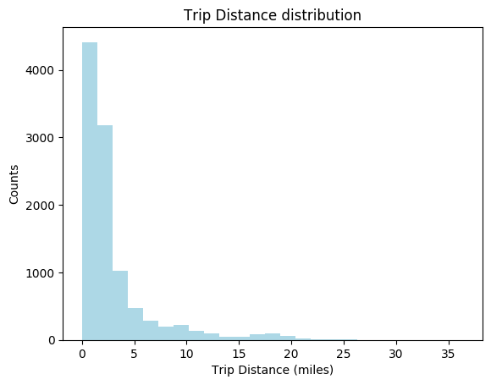
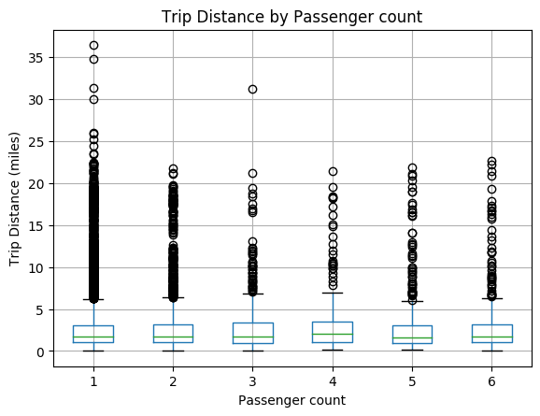
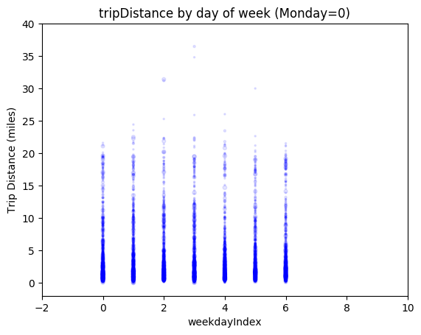
More Plots (Histogram, Box and Scatter)
Different visualizations of the data related to tips that lead to conclusions about the state and quality of the data.

Slide 18
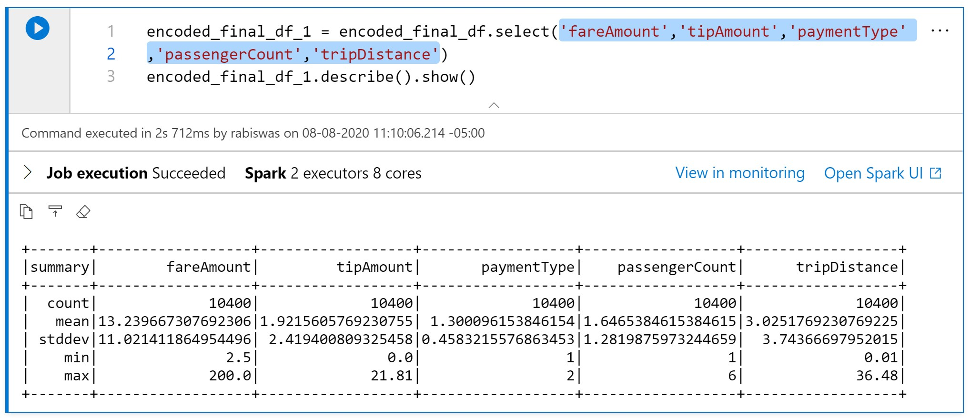
Summary Statitics
Summary statistics for 'fareAmount','tipAmount','paymentType’, 'passengerCount’ and 'tripDistance’.
Note that because of the huge number of rows these statistics are calculated on sample of rows.

Slide 19
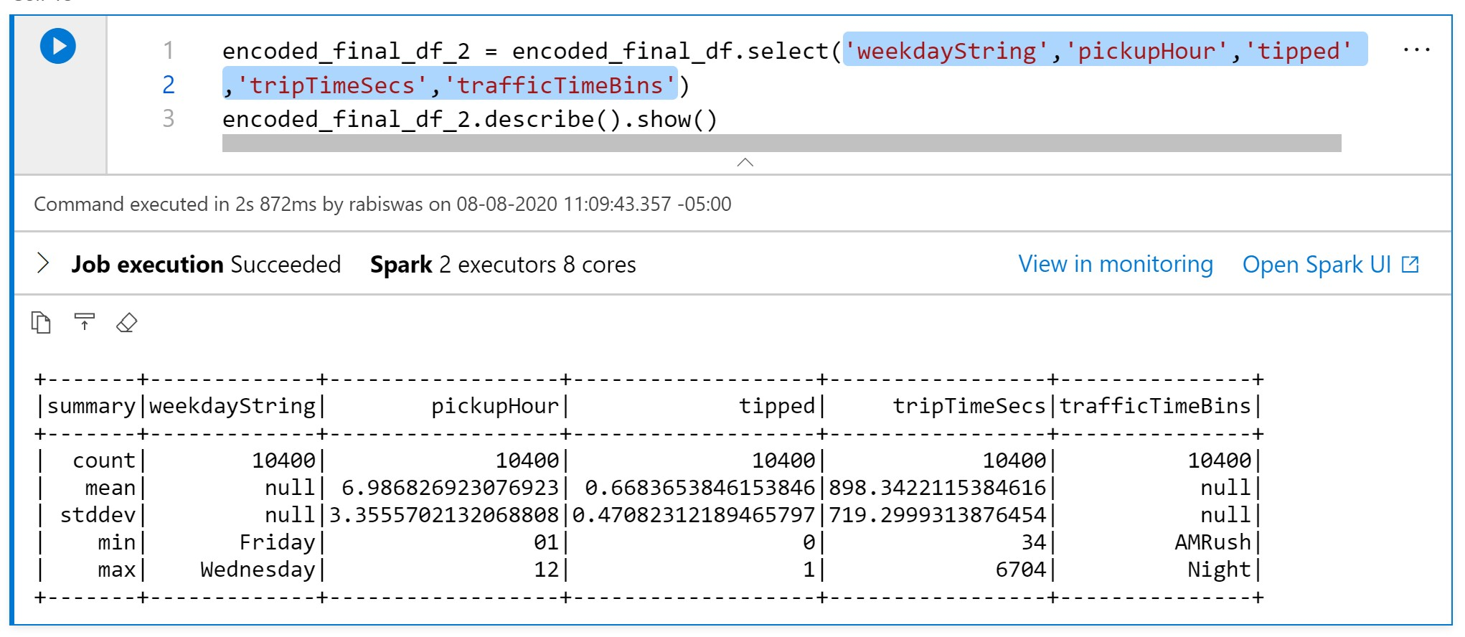
Summary Statitics
Summary statistics for 'weekdayString','pickupHour','tipped'
,'tripTimeSecs’ and 'trafficTimeBins’.
Note that because of the huge number of rows these statistics are calculated on sample of rows.

Slide 20
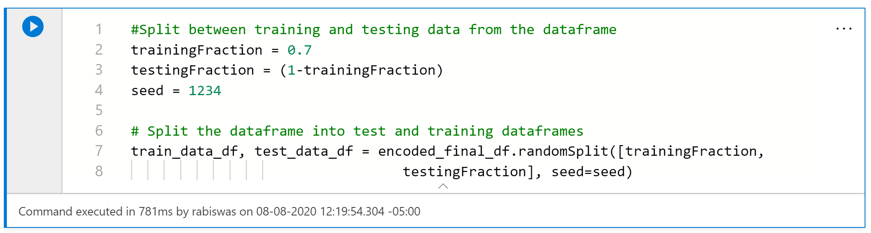
Logistic Regression Model: Train Test Data set
The first task is to split the dataset into a training set and a testing or validation set. I took a 70:30 split for training to testing.

Slide 21
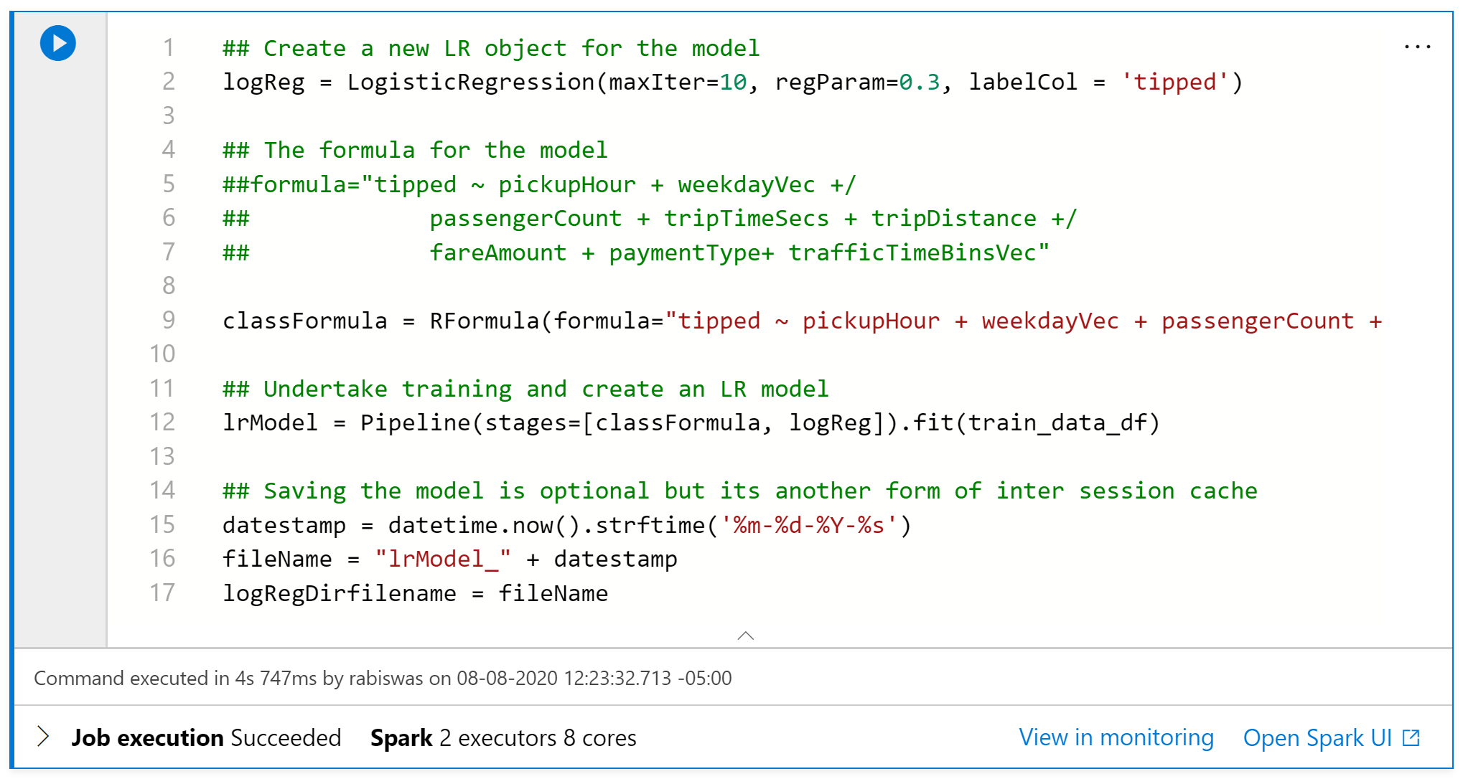
Logistic Regression Model: Create Model
The second task is to select a formula and create the model.

Slide 22
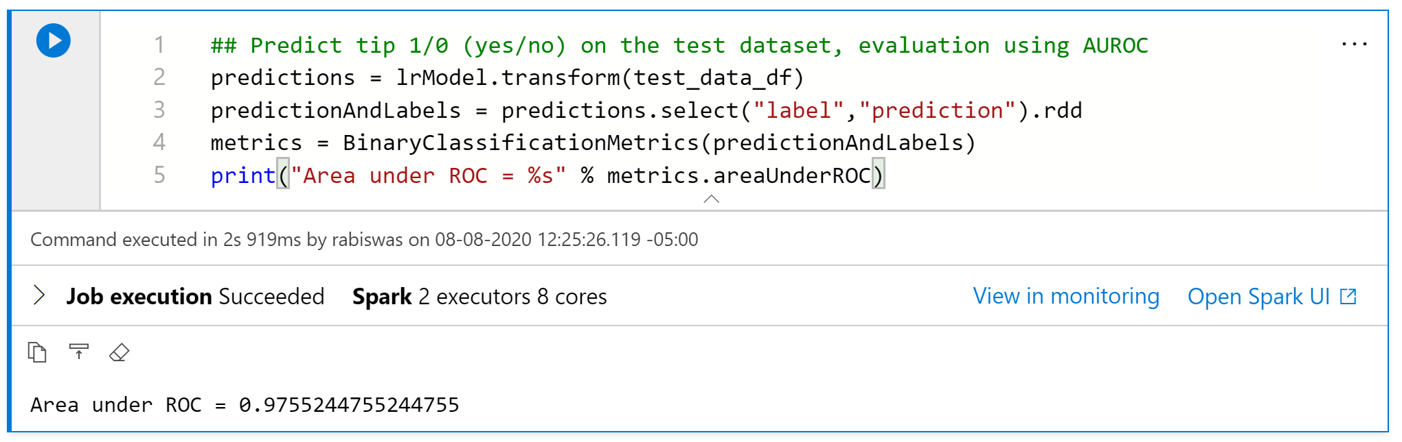
Logistic Regression Model: Test Model
The third task is to test the model. AUROC (Area Under the Receiver Operating Characteristics) can be computed using the trapezoidal rule. In general, an AUC of 0.5 suggests no discrimination (i.e., ability to diagnose patients with and without the disease or condition based on the test), 0.7 to 0.8 is considered acceptable, 0.8 to 0.9 is considered excellent, and more than 0.9 is considered outstanding.

Slide 23
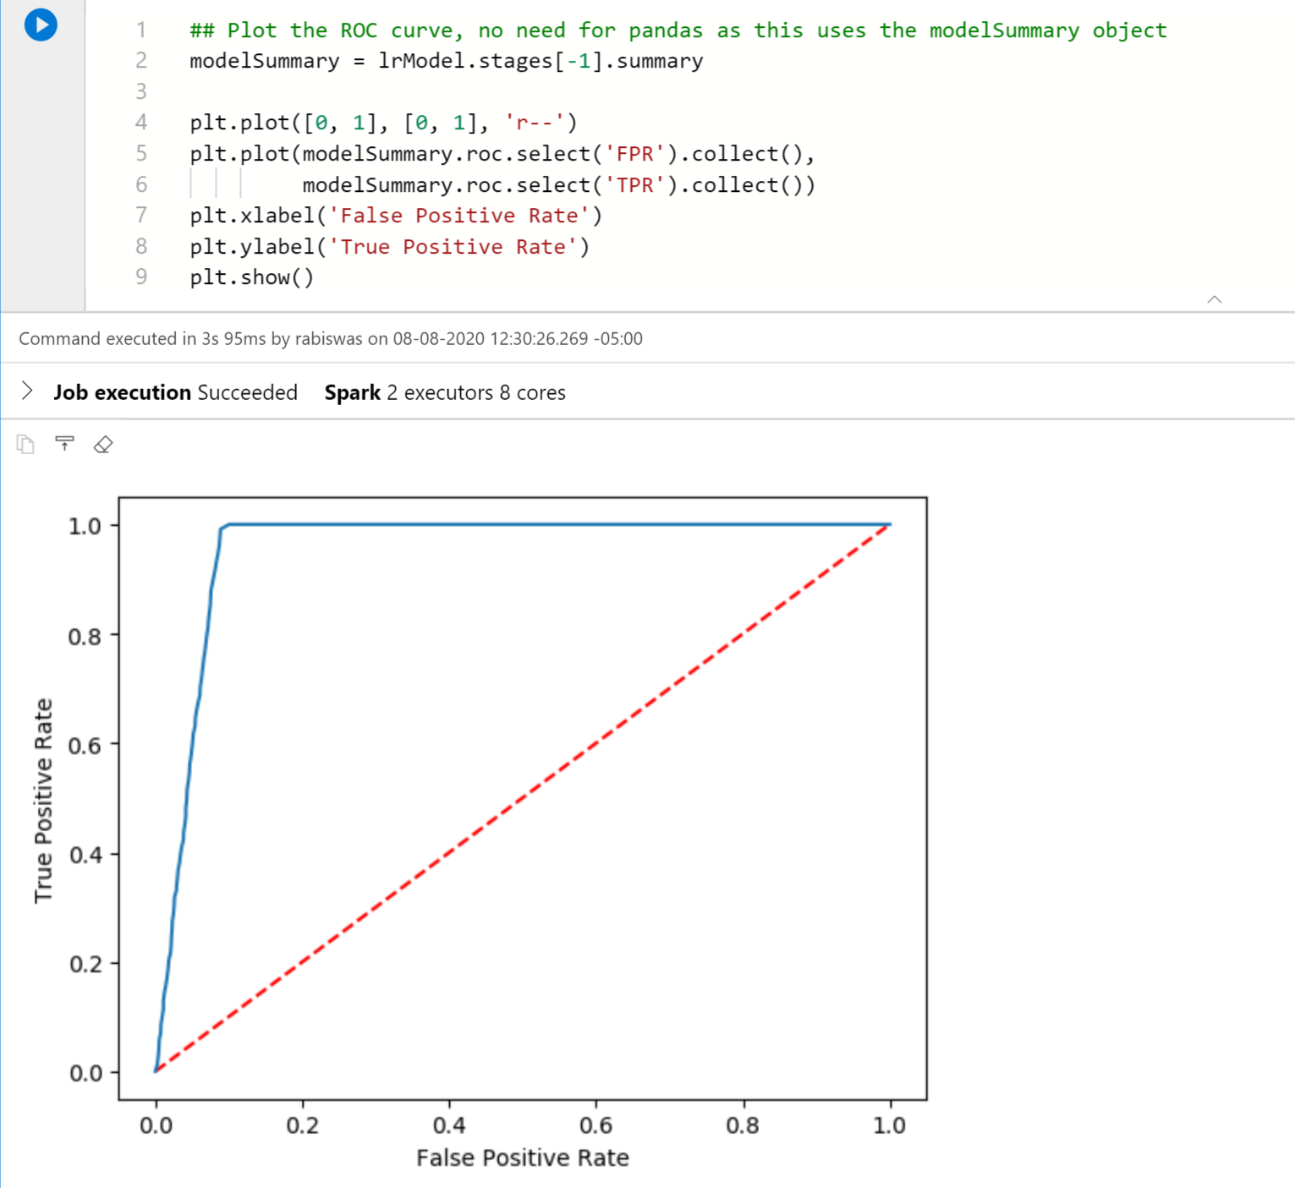
Logistic Regression Model: Visualize the prediction
When we need to check or visualize the performance of the multi - class classification problem, we use AUC (Area Under The Curve) ROC (Receiver Operating Characteristics) curve. It is one of the most important evaluation metrics for checking any classification model’s performance. It is also written as AUROC (Area Under the Receiver Operating Characteristics)

Slide 24
THANK YOU

